Slide 1

PROJECT 1

Slide 2
Project 1 Team
Irene Zou
Jeff Lyng
David Stagner

Slide 3
HYPOTHESIS
Olympic athletes have improved performance significantly over time.

Slide 4
Project Overview
We will analyze summer Olympic games gold medalist data from 1896 to 2016 for 5 specific track & field events for both male and female.
100 meter
800 meter
10,000 meter
High Jump
Discus
We will also analyze height and weight data for the athletes that competed in these events.
Data Source
Kaggle
Olympic Track & Field Results csv
120 Years of Olympic History: Athletes and Results csv

Slide 5
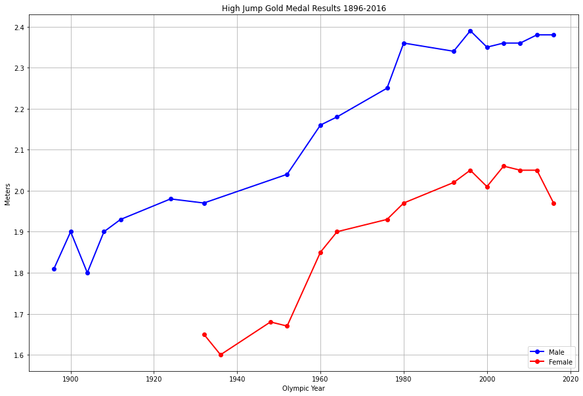
High Jump Results

Slide 6
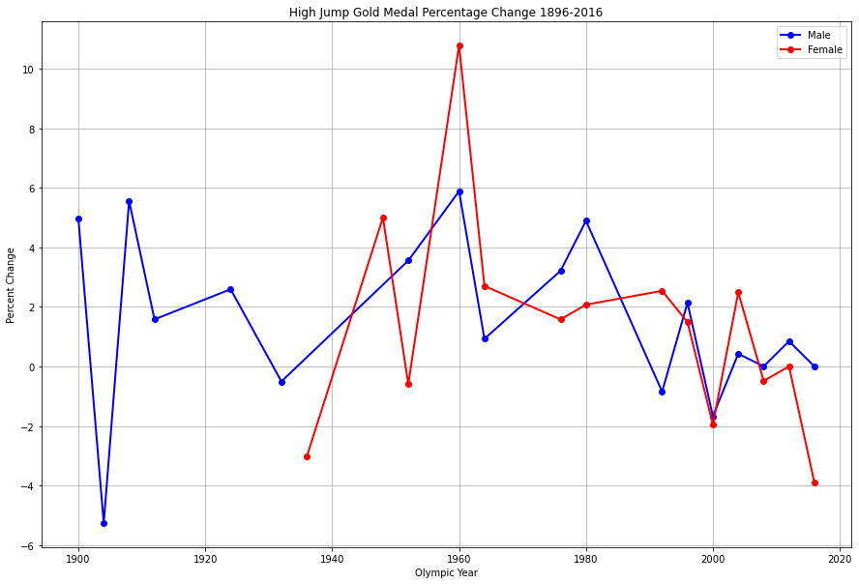
High Jump Percent Change

Slide 7
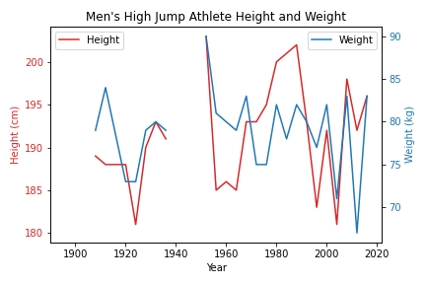
High Jump Men’s Physical Stats

Slide 8
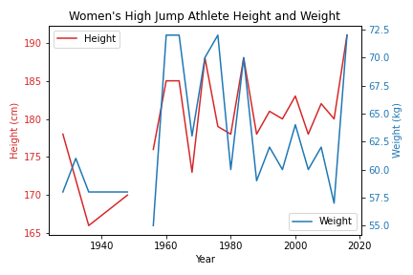
High Jump Women’s Physical Stats

Slide 9
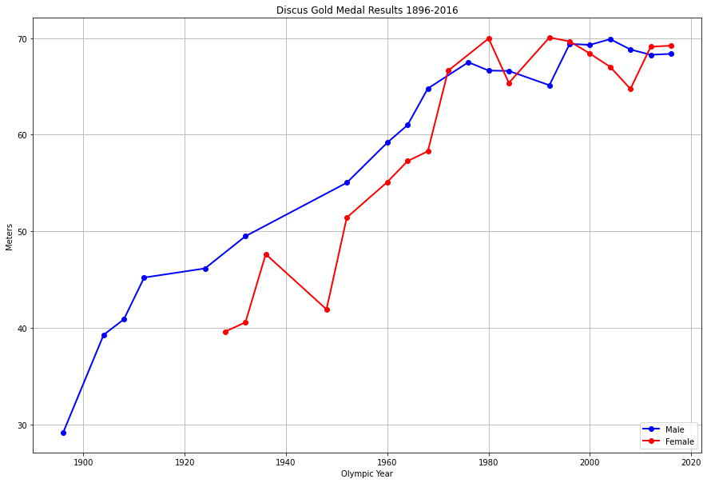
Discus Results

Slide 10
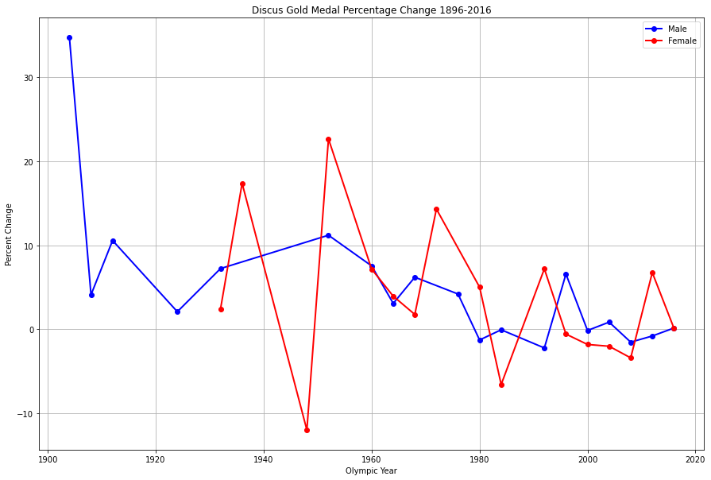
Discus Percent Change

Slide 11
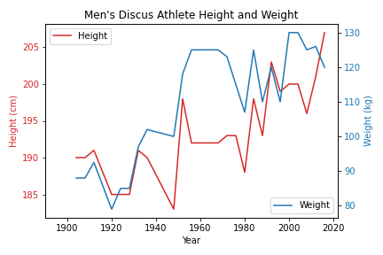
Discus Men’s Physical Stats

Slide 12
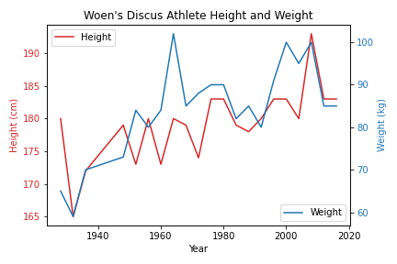
Discus Women’s Physical Stats

Slide 13
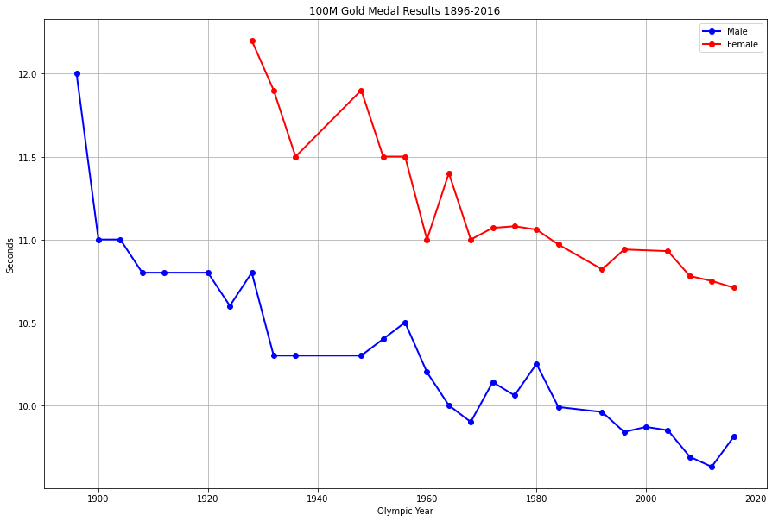
100 Meter Results

Slide 14
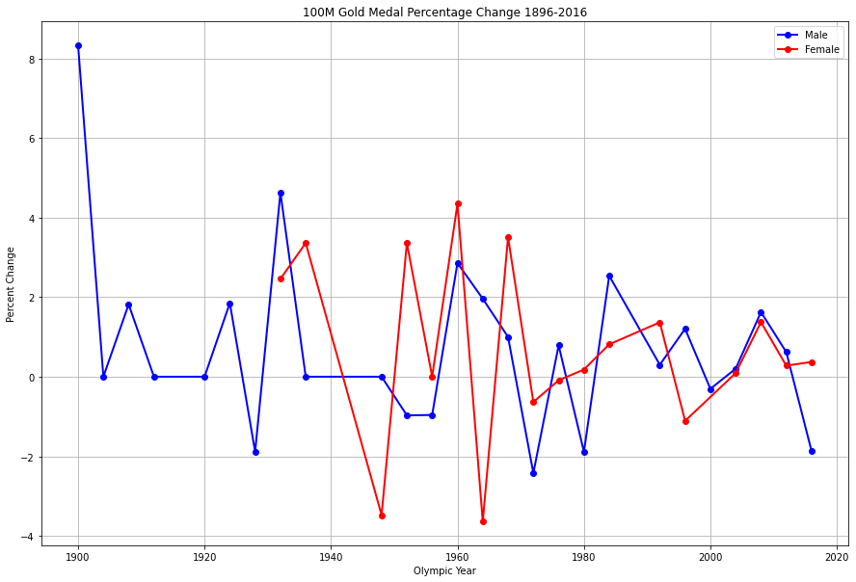
100 Meter Percent Change

Slide 15
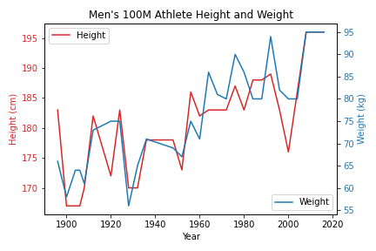
100M Men’s Physical Stats

Slide 16
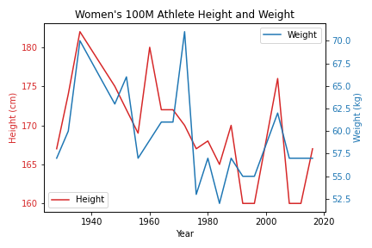
100M Women’s Physical Stats

Slide 17
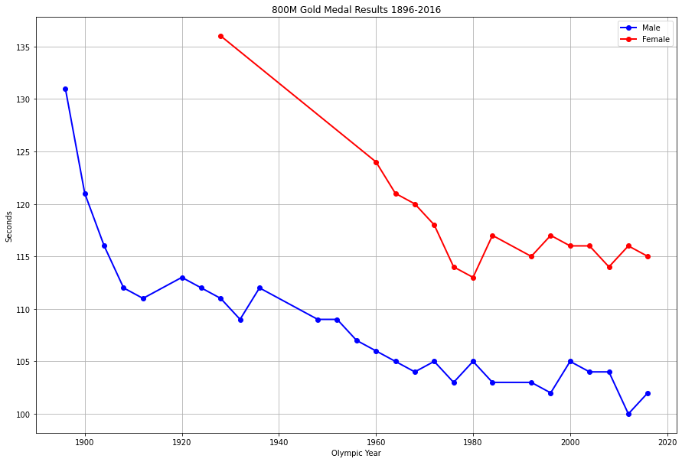
800 Meter Results

Slide 18
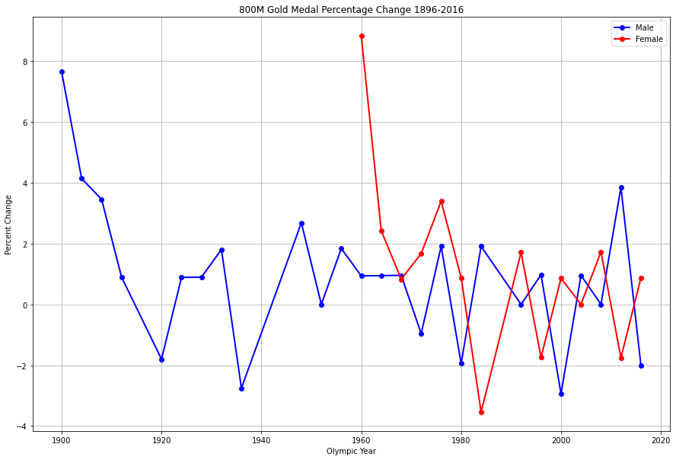
800 Meter Percent Change

Slide 19
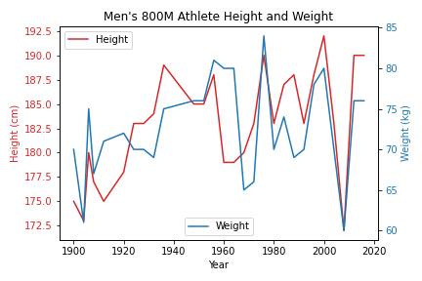
800M Men’s Physical Stats

Slide 20
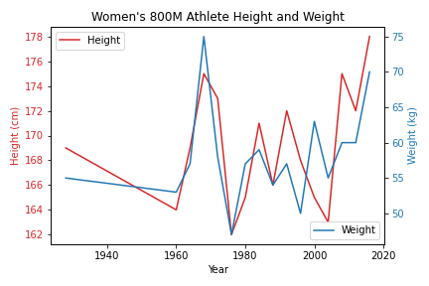
800M Women’s Physical Stats

Slide 21
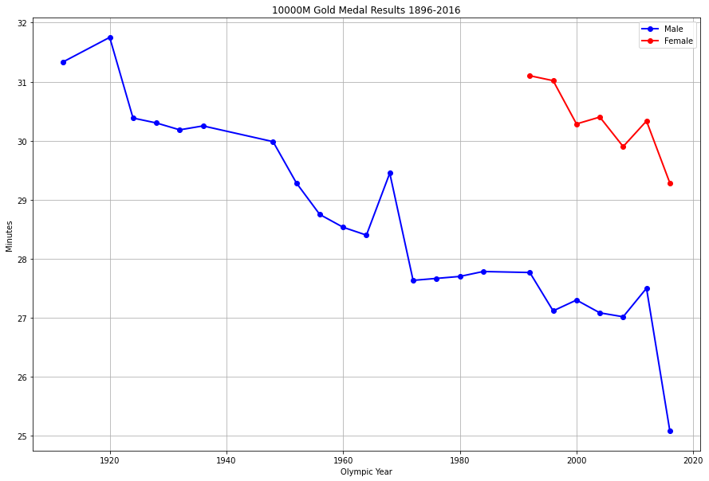
10,000 Meter Results

Slide 22
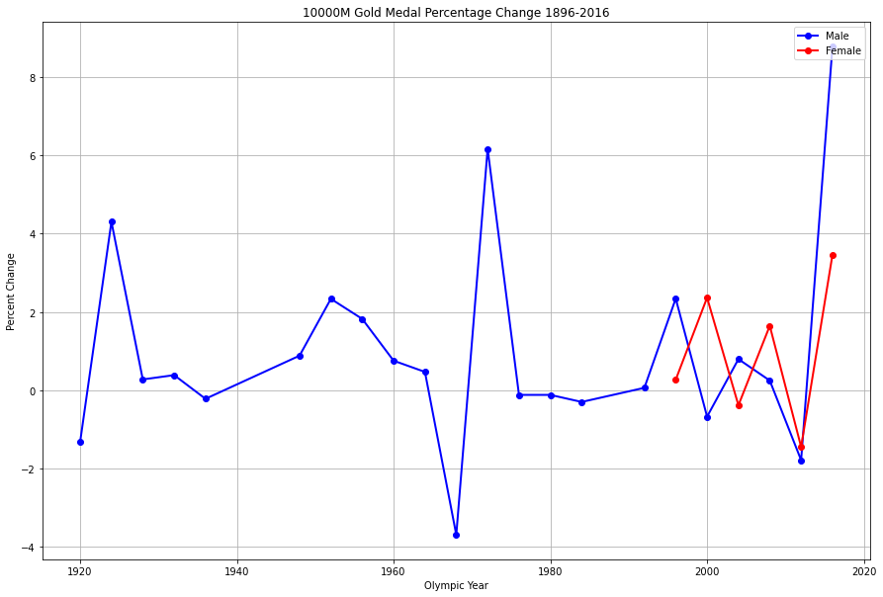
10,000 Meter Percent Change

Slide 23
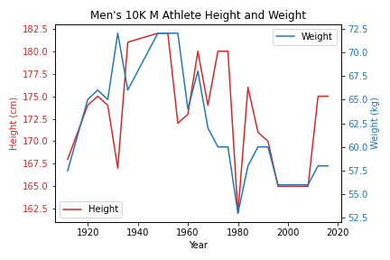
10,000M Men’s Physical Stats

Slide 24
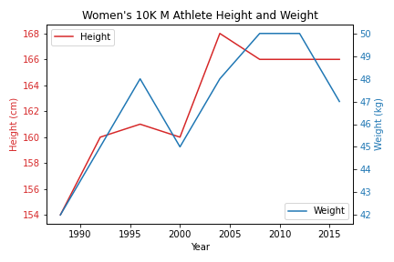
10,000M Women’s Physical Stats

